Slide 1

Interpersonal
relationship
Unit 7
Made by hjw hmh cl lpj

Slide 2

interpersonal relationships are more and more important
01

Slide 3

Why is interpersonal relationship so important?
stay
happy
Something
Something
Something
Something
Something
Something

Slide 4

reach out to help you

Slide 5

accompany you to talk

Slide 6
Why is interpersonal relationship so important?
stay
happy
Something
rarely suffer from mental illnesses
Something
Something
Something
Something
Something

Slide 7

Talk to friend can make you more happy

Slide 8
Why is interpersonal relationship so important?
stay
happy
Something
rarely suffer from mental illnesses
promote the body's metabolism
Something
Something
Something
Something
Something

Slide 9

improves physical fitness and reduce the occurrence of some diseases

Slide 10

How to Make Friends?

Slide 11

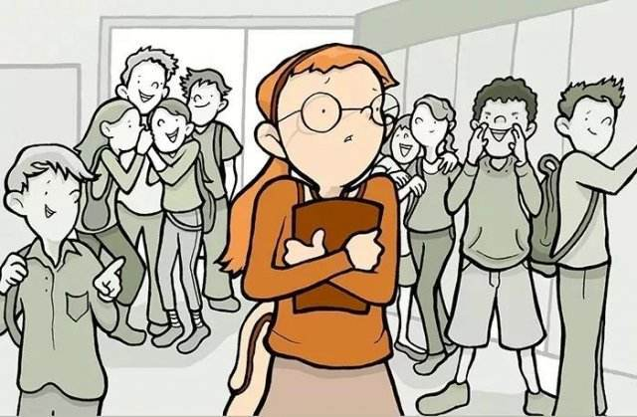
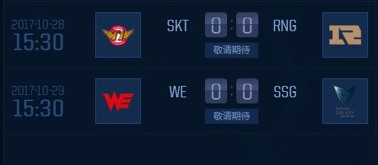
Make friends
know more about your new friend
Start
first
second
third
A good talk
be honesty

Slide 12
02
problem
inevitable

Slide 13
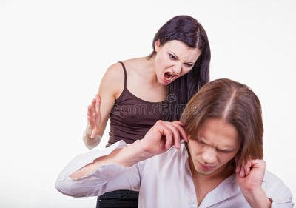
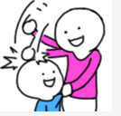
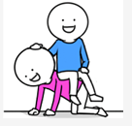


Slide 14

How to deal with an argument？

Slide 15

discuss and negotiate

Slide 16

be a good listener

Slide 17
You also need to admit your mistakes

Slide 18

大哥错了
like this

Slide 19

maintain a good interpersonal relationship

Slide 20
chat with others online

Slide 21
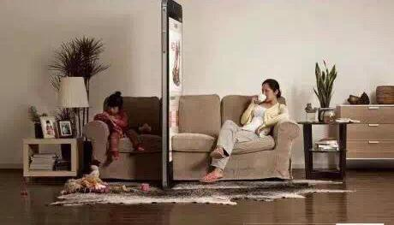
the parents can not touch or hug their child

Slide 22


like this...
Finally,I hope everyone can have a good communication circle in the University and meet some like-minded friends, and can properly deal with all the interpersonal relationships

Slide 23

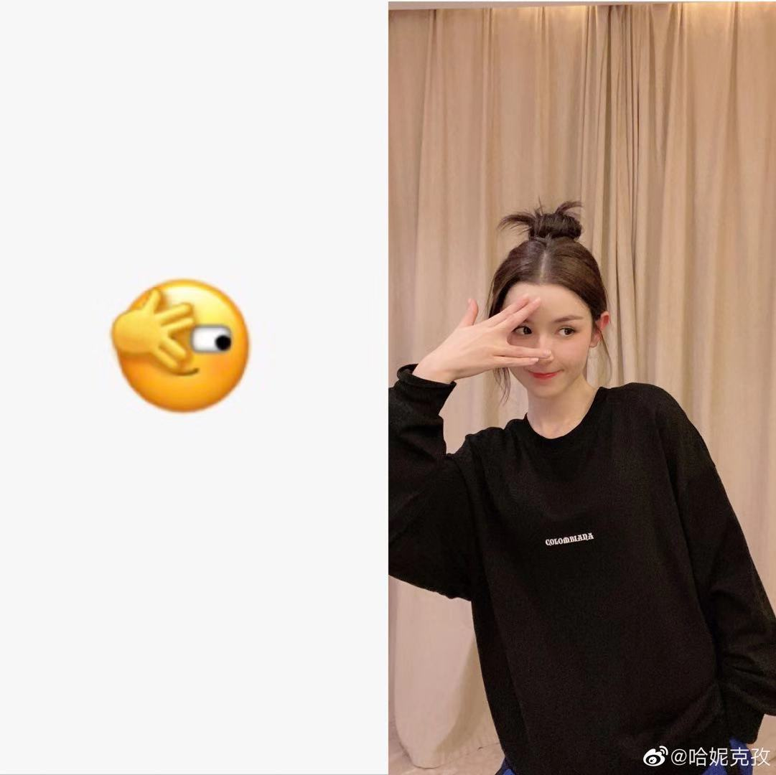
You can find some handsome and beautiful friends

Slide 24
Thank you for your listening

